Slide 1

UNIVERSITY INSTITUTEOF ENGINEERING
Bachelor of Engineering (Computer Science & Engineering)
Operating System (CST-328)
Subject Coordinator: Er. Puneet kaur (E6913)
Introduction to Operating System
DISCOVER . LEARN . EMPOWER
Font size 24

Slide 2
Chapter 5 (Device Management) Device Management: Disk Structure, Disk formatting, Disk Scheduling Algorithms, RAID structure-RAID levels, problems with RAID.

Slide 3
Lecture 18 Disk Structure & Disk Scheduling Algorithms

Slide 4

Why have disks?
Memory is small. Disks are large. 
Short term storage for memory contents (e.g., swap space). 
Reduce what must be kept in memory (e.g., code pages).
Memory is volatile. Disks are forever (?!) 
File storage.

Slide 5
Different types of disks
Advanced Technology Attachment (ATA)
Standard interface for connecting storage devices (e.g., hard drives and CD-ROM drives)
Referred to as IDE (Integrated Drive Electronics), ATAPI, and UDMA.
ATA standards only allow cable lengths in the range of 18 to 36 inches. CHEAP.
Small Computer System Interface (SCSI)
Requires controller on computer and on disk.
Controller commands are sophisticated, allow reordering.
USB connections to ATA disc
These are new bus technologies, not new control. Microdrive – impressively small motors

Slide 6
Different types of disks
Bandwidth ratings
These are unachievable.
50 MB/s is max off platters.
Peak rate refers to transfer from disc device’s memory cache.
SATA II (serial ATA)
3 Gb/s (still only 50 MB/s off platter, so why do we care?)
Cables are smaller and can be longer than pATA
SCSI
320 MB/s ¾ Enables multiple drives on same bus

Slide 7
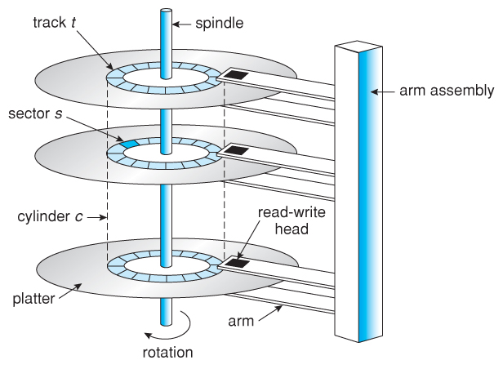
Physical Disk Structure
Disk drives are addressed as large 1- dimensional arrays of logical blocks, where the logical block is the smallest unit of transfer .
The 1-dimensional array of logical blocks is mapped into the sectors of the disk sequentially
Sector 0 is the first sector of the first track (top platter) on the outermost cylinder z
Mapping proceeds in order through that track, then the rest of the tracks in that cylinder, and then through the rest of the cylinders from outermost to innermost

Slide 8
Disk Management
Here are some common things that you can do in Disk Management:
Partition a Drive
Format a Drive
Change a Drive's Letter
Shrink a Partition
Delete a Partition
Change a Drive's File System

Slide 9
Disk Access Time
Two major components
Seek time is the time for the disk to move the heads to the cylinder containing the desired sector
Typically 5-10 milliseconds
Rotational latency is the additional time waiting for the disk to rotate the desired sector to the disk head Typically, 2-4 milliseconds
One minor component
Read/write time or transfer time – actual time to transfer a block, less than a millisecond

Slide 10
Disk Scheduling
Should ensure a fast access time and disk bandwidth
Fast access
Minimize total seek time of a group of requests
If requests are for different cylinders, average rotation latency has to be incurred for each anyway, so minimizing it is not the primary goal (though some scheduling possible if multiple requests for same cylinder is there)
Seek time ≈ seek distance
Main goal : reduce total seek distance for a group of requests
Auxiliary goal: fairness in waiting times for the requests
Disk bandwidth is the total number of bytes transferred, divided by the total time between the first request for service and the completion of the last transfer

Slide 11
Disk Scheduling
Several algorithms exist to schedule the servicing of disk I/O requests.
We illustrate them with a request queue (0-199).
98, 183, 37, 122, 14, 124, 65, 67
Head pointer 53

Slide 12
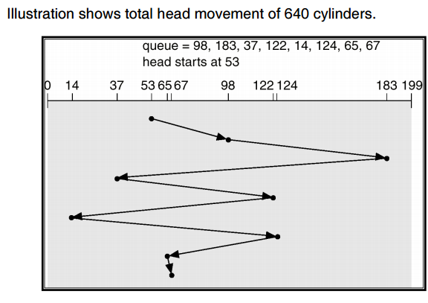
FCFS
Service requests in the order they come
Fair to all requests
Can cause very large total seek time over all requests if the load is moderate to high

Slide 13
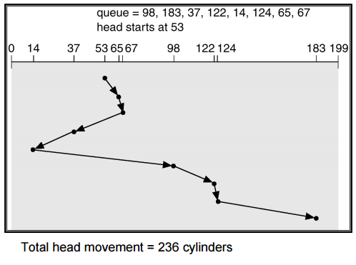
SSTF
Selects the request with the minimum seek time from the current head position
SSTF scheduling is a form of SJF scheduling
May cause starvation of some requests like SJF
But not optimal, unlike SJF
Minimizes seek time, but not fair
May work well if the load is not high

Slide 14
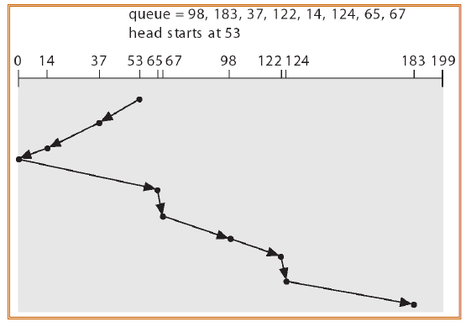
SCAN
The disk arm starts at one end of the disk, and
moves toward the other end, servicing requests
until it gets to the other end of the disk, where
the head movement is reversed and servicing
continues
Sometimes called the elevator algorithm

Slide 15
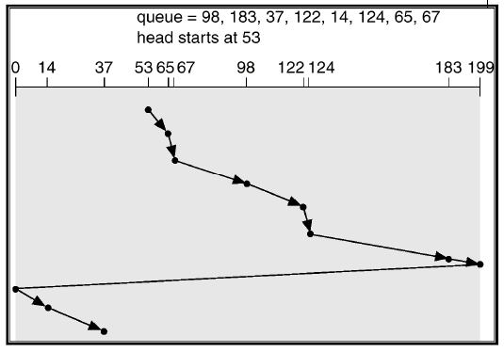
C-SCAN
Provides a more uniform wait time than SCAN
The head moves from one end of the disk to the other. servicing requests as it goes. When it reaches the other end, however, it immediately returns to the beginning of the disk, without servicing any requests on the return trip
Treats the cylinders as a circular list that wraps around from the last cylinder to the first one

Slide 16
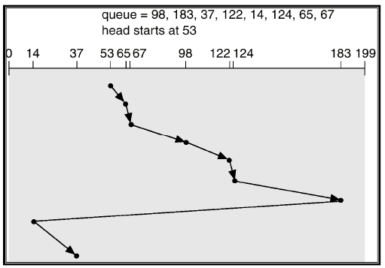
C-LOOK
Version of C-SCAN
Arm only goes as far as the last request in each direction, then reverses direction immediately, without first going all the way to the end of the disk.

Slide 17
Selecting a Disk-Scheduling Algorithm
SSTF is common and has a natural appeal
SCAN and C-SCAN perform better for systems that place a heavy load on the disk
Performance depends on the number and types of requests
Requests for disk service can be influenced by the file allocation method
The disk-scheduling algorithm should be written as a separate module of the operating system, allowing it to be replaced with a different algorithm if necessary
Either SSTF or C-LOOK is a reasonable choice for the default algorithm (depending on load)

Slide 18
Conclusion
This lecture makes students familiar with the Disk management and various disk scheduling algorithms

Slide 19
Video Link
https://www.youtube.com/watch?v=ZjMwUhapSEM
https://www.youtube.com/watch?v=6RyXRde6K00

Slide 20
References
https://www.javatpoint.com/os-disk-scheduling
https://www.cs.uic.edu/~jbell/CourseNotes/OperatingSystems/8_MainMemory.html#:~:text=8.3%20Contiguous%20Memory%20Allocation,allocated%20to%20processes%20as%20needed.
http://www.csdl.tamu.edu/~furuta/courses/99a_410/slides/chap08
https://www.geeksforgeeks.org/disk-scheduling-algorithms/
https://www.gatevidyalay.com/disk-scheduling-disk-scheduling-algorithms/
http://www.cs.iit.edu/~cs561/cs450/disksched/disksched.html

